Slide 1

Computer Science Department
Distributed Intelligence Model for Internet of Things Applications
by
Baha Rababah
©Copyright 2021 by Baha Rababah

Slide 2

Contents:
Introduction
Model Design
Implementation
Evaluation
Conclusions
Future Work
References

Slide 3
IoT gateway segment, controller ( e.g. raspberry pi) shortened the development of IoT applications.
The complication is still at the software level.
Those boards are not intelligence enough to extract the knowledge from the raw data.
Those boards are have limited computational capabilities.
1. Introduction

Slide 4
1. Introduction
Contributions
This Work present a Distributed Intelligence Model (DIM).
Distributed intelligence in IoT means to distribute the intelligence over the edge and cloud layers in order to provide the required functionality and performance for IoT applications.
It will enable IoT gateway to extract most of the knowledge from the sensors’ data in order to make the decision without sending the data to the cloud.
If the gateway unable to achieve the task, the task will be offloaded to the cloud.

Slide 5
1. Introduction
Contributions
Distributed Intelligence Model (DIM) Features:
Local data processing of the most real time data for fast decision and action making.
Offload coming tasks when the gateway is overload.
Avoid sending most of the data to the cloud for security and privacy purposes.
Enable IoT network to be more resourceful in terms of energy and communication bandwidth.

Slide 6
2. Design
The Proposed Model
Designing Edge Intelligence
Designing Cloud Intelligence
Workflow

Slide 7
2. Design
Designing Edge Intelligence
IoT Gateway:
Receive data and task from end devices.
Decide where the task should be executed.
Process local tasks based on an Neural Networks algorithm.

Slide 8
2. Design
Designing Edge Intelligence
IoT Gateway task offloading decision:
CPU utilization threshold (t).
Locally.
Offload.

Slide 9
2. Design
Designing Edge Intelligence
IoT Gateway process local tasks basaed on ANN:
Artificial Neural Networks (ANN):
Multi-layer Perceptron Neural Networks (MLPNN).
Feed Forward Neural Networks based on LSTM (FFNN1).
Feed Forward Neural Networks based on GRUs (FFNN2).
We built the two feedforward neural networks based on RNNs (e.g LSTMs and GRUs) architectures because they performed well in some works of non-sequential data \cite{mao2014deep, chopra2017recurrent}, Although RNNs are mainly designed for processing sequential data.

Slide 10
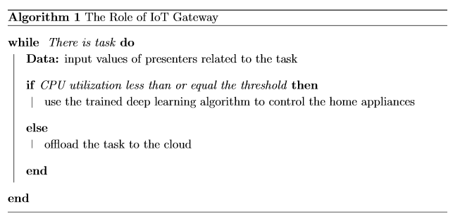
2. Design
Designing Edge Intelligence
IoT Gateway Role.

Slide 11
2. Design
Designing Cloud Intelligence
Receive offloaded task.
Processes tasks based on prior-beliefs probability distribution.

Slide 12
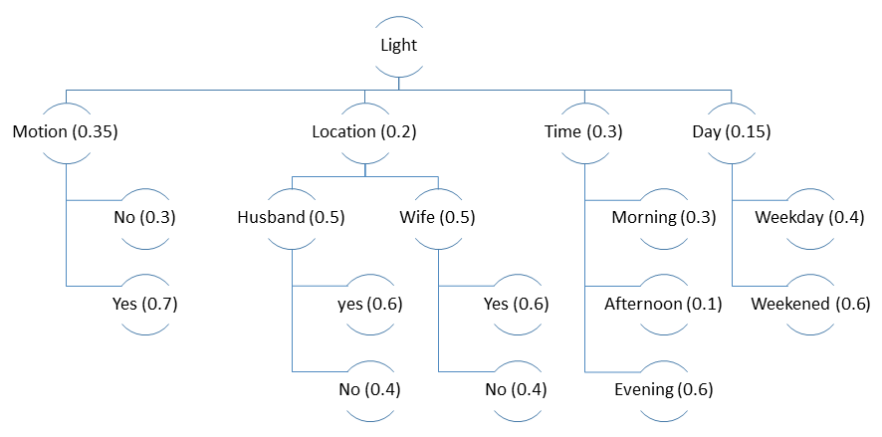
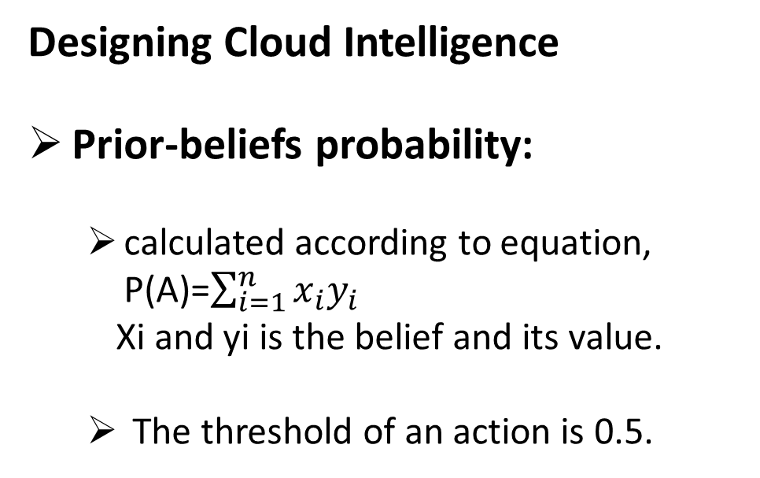
2. Design
Designing Cloud Intelligence
Prior-beliefs probability:
calculated according to equation, P(A)=$\sum_{i=1}^{n}{x_{i}y_{i}}$
Xi and yi is the belief and its value.
The threshold of an action is 0.5.

Slide 13
2. Design
Designing Cloud Intelligence
Prior-beliefs probability example:
motion sensor does not detect motion,
husband and wife are inside,
time is evening,
day is weekend,
The probability of turning the light on/off, is:
P(l) = (0.35 * 0.3) +2 (0.2 * 0.5 * 0.6) + (0.3 * 0.6) + (0.15 * 0.6) = 0.495.
P(l) < 0.5.
The decision is to turn the light off.

Slide 14
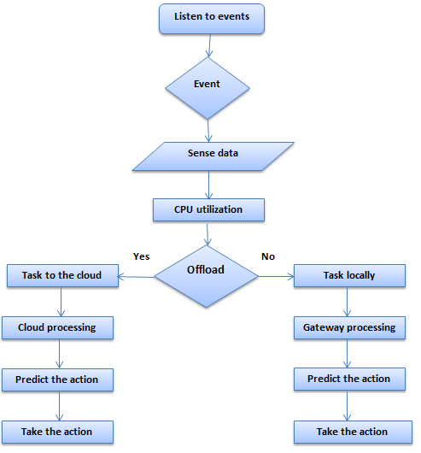
2. Design
Workflow

Slide 15
3. Implementation
The Operational Model
Real experiment of Distributed Intelligence smart home IoT system is conducted.
Combines cloud and edge to control the light and temperature in the living room.
A husband and wife live in the house.

Slide 16
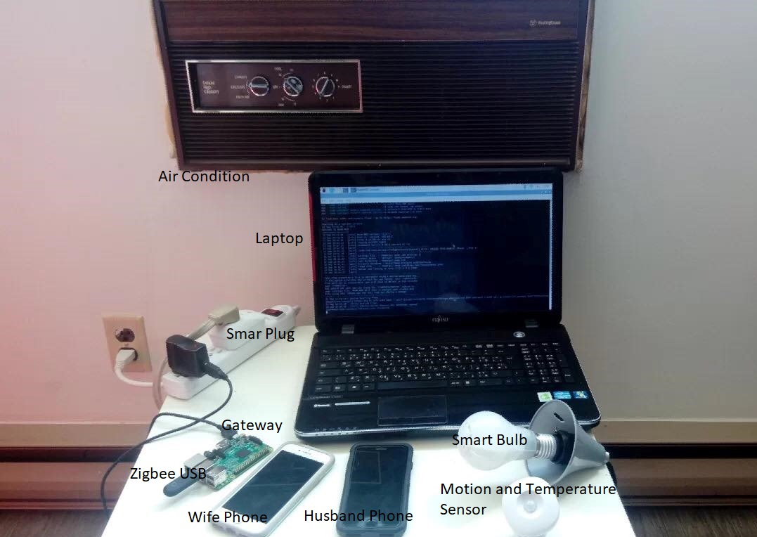
3. Implementation
The Operational Model

Slide 17
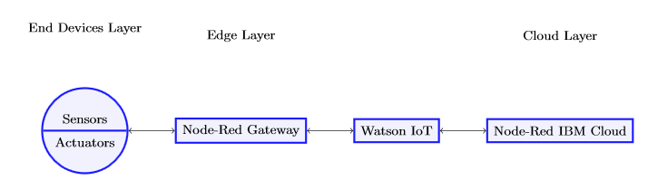
3. Implementation
The Operational Model
The implementation has three main phases:
End devices layer implementation.
Edge layer implementation.
Cloud layer implementation.

Slide 18
3. Implementation
The Operational Model
End devices layer:
Consists of sensors and actuators.
Devices:
Motion sensor.
Temperature sensor.
Smart bulb.
Smart plug.
Mobile phones (for husband and wife).
Devices | Producer | Communication
Smart Plug | Sylvania | ZigBee
Motion sensor | Samsung | ZigBee
Temp sensor | Samsung | ZigBee
Bulb | Cree | ZigBee
iPhone 7 | Apple | Wi-Fi
iPhone 8 | Apple | Wi-Fi

Slide 19
3. Implementation
The Operational Model
Edge Layer:
IoT gateway.
Raspberry Pi 3 Model.
Raspbian GNU/Linux version 10.
Manage and control end layer devices.
Connecting devices in the end layer to the IoT gateway:
Wi-Fi .
ZigBee USB (Conbee II).
Node-Red platform (v1.0.3)

Slide 20
3. Implementation
The Operational Model
Edge Layer:
The gateway collects the sensors’ data every 10 minutes for two weeks and save it in a csv file to create two datasets (for light and temperature).

Slide 21
3. Implementation
The Operational Model
Edge Layer:
Light’s dataset features:
Light status.
Motion.
Husband’s location.
Wife’s location.
Day.
Time.

Slide 22
3. Implementation
The Operational Model
Edge Layer:
Temperature’s dataset features:
Air condition’s status.
Temperature.
Motion.
Husband’s location.
Wife’s location.
Time.

Slide 23
3. Implementation
The Operational Model
Cloud Layer:
IBM cloud.
Node-Red Starter Kit.
Prior beliefs.

Slide 24
3. Implementation
Intelligent IoT Gateway
Artificial Neural Networks (ANN):
Multi-layer Perceptron Neural Networks (MLPNN).
Feed Forward Neural Networks based on LSTM (FFNN1).
Feed Forward Neural Networks based on GRUs (FFNN2).
We built the two feedforward neural networks based on RNNs (e.g LSTMs and GRUs) architectures because they performed well in some works of non-sequential data \cite{mao2014deep, chopra2017recurrent}, Although RNNs are mainly designed for processing sequential data.

Slide 25
3. Implementation
Intelligent IoT Gateway
Python.
an input layer, a hidden layer, and an output layer.
For controlling the light, the input layer has five neurons.
Motion.
Husband’s location.
Wife’s location.
Time.
Day.

Slide 26
3. Implementation
Intelligent IoT Gateway
For controlling the temperature, the input layer has five neurons .
Motion.
Temperature.
Husband’s location.
Wife’s location.
Time.

Slide 27
3. Implementation
Intelligent IoT Gateway
For MLPNN, the number of neurons in the hidden layer is chosen experimentally:
using cross validation:
testing all the values from the number of neurons in input layer to less than twice of the number of neurons in input layer.

Slide 28
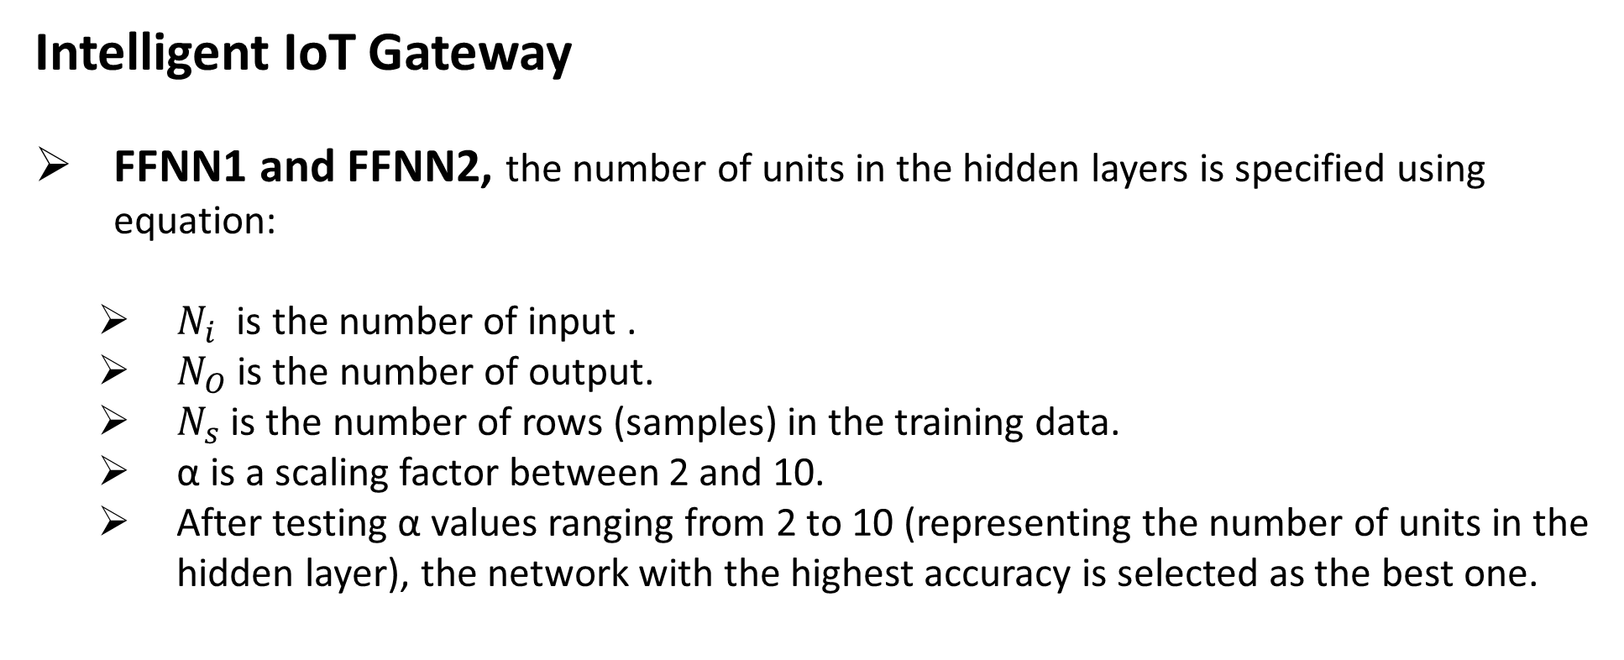
3. Implementation
Intelligent IoT Gateway
FFNN1 and FFNN2, the number of units in the hidden layers is specified using equation:
$N_{i}$ is the number of input .
$N_{O}$ is the number of output.
$N_{s}$ is the number of rows (samples) in the training data.
α is a scaling factor between 2 and 10.
After testing α values ranging from 2 to 10 (representing the number of units in the hidden layer), the network with the highest accuracy is selected as the best one.

Slide 29
3. Implementation
Intelligent IoT Gateway
Next step is the training.
Training means using a learning algorithm to estimate network weight to reduce the overall error between the value estimated by the trained network and the target value.

Slide 30
3. Implementation
Intelligent IoT Gateway
Parameters | MLPNN | FFNN1 | FFNN2
Hidden layers | 1 | 1 | 1
Activation function | sigmoid | relu | relu
Nodes | 9 | 50 | 50
Optimizer | adam | adam | adam
Loss | binary_crossentropy | binary_crossentropy | binary_crossentropy
epochs | 10 | 10 | 10
Batch size | 5 | 5 | 5
Verbose | 1 | 1 | 1

Slide 31
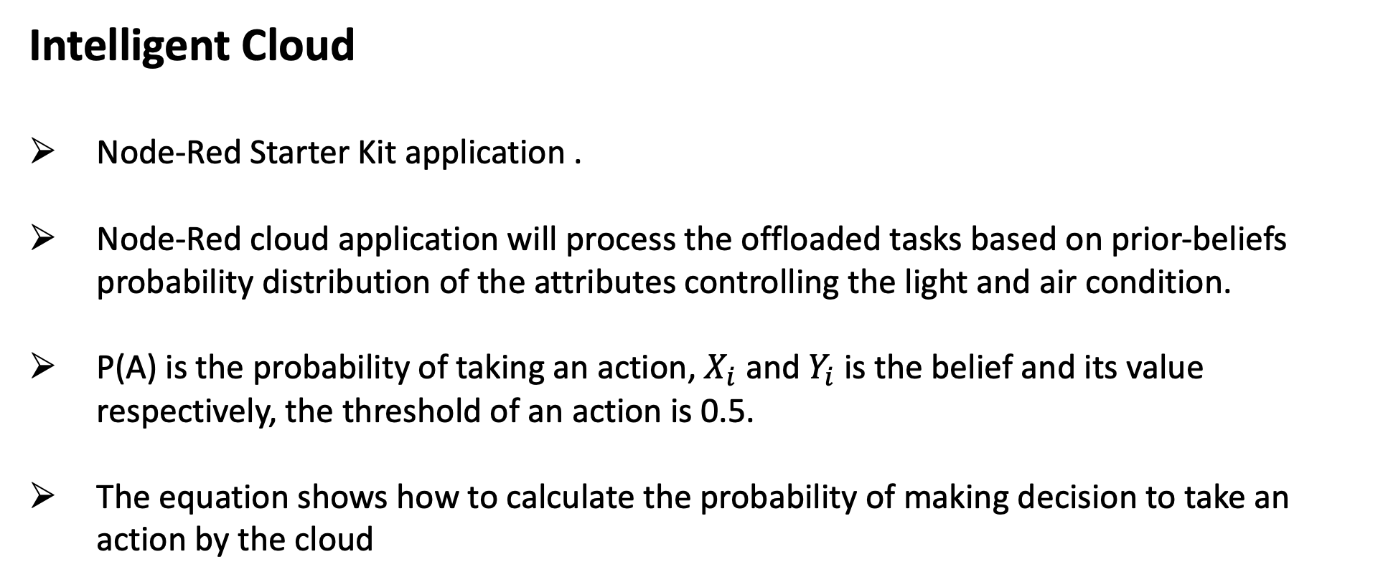
3. Implementation
Intelligent Cloud
Node-Red Starter Kit application .
Node-Red cloud application will process the offloaded tasks based on prior-beliefs probability distribution of the attributes controlling the light and air condition.
P(A) is the probability of taking an action, $X_{i}$ and $Y_{i}$ is the belief and its value respectively, the threshold of an action is 0.5.
The equation shows how to calculate the probability of making decision to take an action by the cloud

Slide 32
4. Evaluation
Artificial Neural Networks Algorithms
IoT Gateway Performance

Slide 33
4. Evaluation
Artificial Neural Networks Algorithms
Confusion Matrix.
Comparison of the three algorithms.
ROC (Receiver Operating Characteristic ) curve.

Slide 34
4. Evaluation
Artificial Neural Networks Algorithms
Confusion Matrix.
 | Predicted: No |  |  | Predicted: Yes
 | MLPNN | FFNN1 | FFNN2 | MLPNN | FFNN1 | FFNN2
Actual: No | 626 | 612 | 603 | 1 | 15 | 24
Actual: Yes | 98 | 20 | 17 | 39 | 117 | 120
 | Predicted 0 | Predicted 1
Actual 0 | TN | FP
Actual 1 | FN | TP

Slide 35
4. Evaluation
Artificial Neural Networks Algorithms
Comparison of the three algorithms with respect to:
Accuracy is simply a ratio of correct predictions to the overall observations. (TP+TN)/(N+P)
Precision is the ratio of correctly predicted positive observations to all predicted positive observations. TP/(TP+FP)
Recall is a ratio of correctly predicted positive observations to all observations in the actual ‘yes’ class. TP/(TP+FN)
F1-score is a weighted average of precision and recall. F1 = 2*Precision*Recall/(Precision + Recall)

Slide 36
4. Evaluation
Comparison of the three ANN algorithms.
Parameters | Accuracy (%) | Precision (%) | Recall (%) | F1-Score (%)
MLPNN | 87 | 28 | 80 | 44
FFNN1 | 95 | 85 | 89 | 87
FFNN2 | 95 | 88 | 83 | 85

Slide 37
4. Evaluation
Artificial Neural Networks Algorithms
ROC curve: It is a plot of the false positive rate (x-axis) versus the true positive rate (y-axis)
False Positive Rate = False Positives / (False Positives + True Negatives)
True Positive Rate = True Positives / (True Positives + False Negatives)

Slide 38
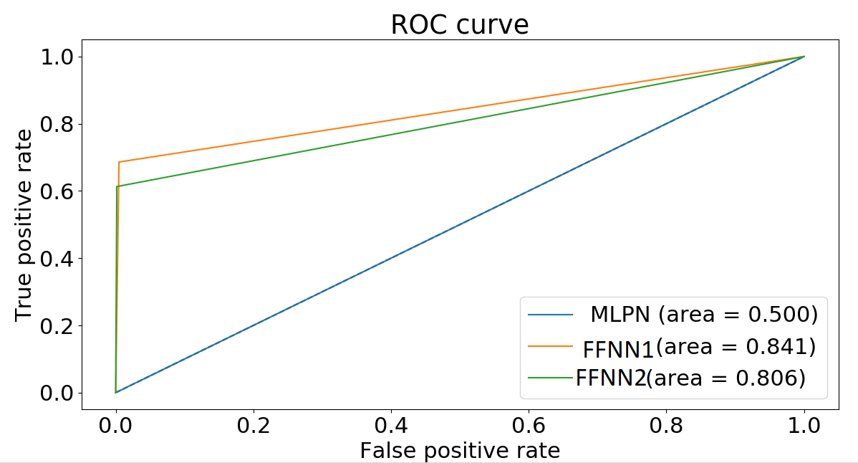
4. Evaluation
Artificial Neural Networks Algorithms
ROC curve:
MLPNN: 0.50
FFNN1: 0.84
FFNN2: 0.80

Slide 39
4. Evaluation
IoT Gateway Performance
Two scenarios were built.
Offloading ( DIM).
No offloading (local ).
The scenarios were compared according to:
Tasks Processing Time.
Gateway CPU Utilization.

Slide 40
4. Evaluation
IoT Gateway Performance
This process starts with four parallel tasks (two light-control tasks and two temperature-control tasks).
When one of the tasks ends, the gateway chooses a random delay (1-20 seconds) to start another task

Slide 41
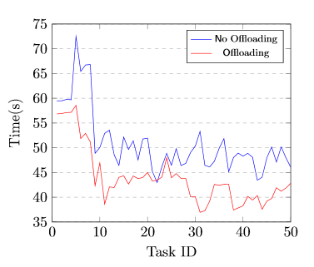
4. Evaluation
IoT Gateway Performance
Tasks Processing Time.
presents the processing times of the first 50 tasks processed locally for both no-offloading and offloading.
No Offloading (DIM): 42 s and 53 s.
Offloading 36 s and 46 s.
Enforcing the gateway to process all coming tasks locally causes either a delay or a connection loss when it is overloaded.

Slide 42
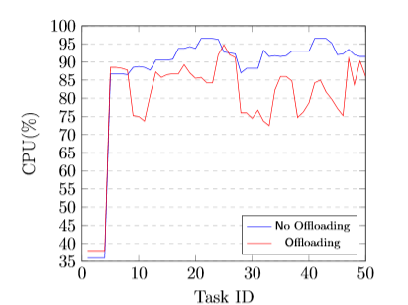
4. Evaluation
IoT Gateway Performance
No offloading: fluctuating between 87% and 96% for all remaining tasks.
Offloading: fluctuating between 72% and 94%.
With offloading, it is less than 90% most of the time.
without offloading is usually greater than 90%.

Slide 43
4. Evaluation
IoT Gateway Performance
The no-offloading scenario enforces all new tasks to be processed locally without testing the operation of the gateway.
The gateway might be unable to process more tasks because doing so would cause service interruptions.
The offloading threshold guarantees that the CPU utilization never reaches 100%, which ensures that the gateway runs smoothly and continuously without any service interruptions.

Slide 44
4. Evaluation
Distributed Intelligence Model (DIM)
Local data processing of the most real time data for fast decision and action making.
Offload coming tasks when the gateway is overload.
Avoid sending most of the data to the cloud for security and privacy purposes.
Enable IoT network to be more resourceful in terms of energy and communication bandwidth.

Slide 45
5. Conclusion
The concept of Distributed Intelligence (DI) in the context of Internet of Things(IoT) was presented.
We investigated in details the ability of an IoT gateway and cloud to process IoT data.
We conducted a proof of concept implementation of an IoT system that includes our demonstration of the Distributed Intelligence Mode.
The model was applied to a smart home system, aimed to control home appliances.

Slide 46
5. Conclusion
Three types of Artificial Neural Networks were evaluated.
The results showed that FFNN1 has the best performance over MLPNN and FFNN2
FFNN1 is implemented on the gateway to process the local tasks to control home appliances based on past experience.
For processing offloaded task on the cloud, we implemented prior beliefs on the cloud.

Slide 47
5. Conclusion
We built two scenarios for evaluating our model that are edge based smart home system and Distributed Intelligence smart home system.
We compared between the scenarios with regard to task processing time and gateway CPU utilization.
The model showed that the collaboration between the gateway and the cloud helps the gateway to run smoothly and continuously without service interruption.

Slide 48
5. Contributions
Local data processing of the most real time data for fast decision and action making.
Offload coming tasks when the gateway is overload.
Avoid sending most of the data to the cloud for security and privacy purposes.
Enable IoT network to be more resourceful in terms of energy and communication bandwidth.

Slide 49
5. Contributions
Rababah B, Alam T, Eskicioglu R. The Next Generation Internet of Things Architecture Towards Distributed Intelligence: Reviews, Applications, and Research Challenges. Journal of Telecommunication, Electronic and Computer Engineering (JTEC). 2020 Jul 1;12(2).
Rababah B, Eskicioglu R. Distributed Intelligence Model for IoT Applications Based on Neural Networks. International Journal of Computer Network and Information Security(IJCNIS), accepted.

Slide 50
5. Future work
In order to enhance the presented model, a few work can be performed in the future:
Implement an Artificial Neural Networks (ANN) algorithm on the cloud.
Investigate another offloading criteria and compare between them for supporting service level.
Finally, test the model for large scale IoT systems such as traffic management.

Slide 51
6. References
[1] R. Kandaswamy and D. Furlonger,Blockchain-based transformation: A gart-ner trend insight report,https : / / www . gartner . com / en / doc / 3869696 -blockchain-based-transformation-a-gartner-trend-insight-report#a-1126710717, Last accessed on 2020-04-04, May 2013.
[2] J. Miranda, N. M ̈akitalo, J. Garcia-Alonso, J. Berrocal, T. Mikkonen, C. Canal,and J. M. Murillo, “From the internet of things to the internet of people,”IEEEInternet Computing, vol. 19, no. 2, pp. 40–47, 2015.
[3] K. Ashton, “That ‘internet of things’ thing,”RFID journal, vol. 22, no. 7,pp. 97–114, 2009.
[4] J.-W. Yoon, Y.-k. Ku, C.-S. Nam, and D.-R. Shin, “Sensor network middle-ware for distributed and heterogeneous environments,” in2009 InternationalConference on New Trends in Information and Service Science, IEEE, 2009,pp. 979–982.
[5] J. Bian, D. Fan, and J. Zhang, “The new intelligent home control systembased on the dynamic and intelligent gateway,” in2011 4th IEEE Interna-tional Conference on Broadband Network and Multimedia Technology, IEEE,2011, pp. 526–530

Slide 52
6. References
[6] S. M. Babu, A. J. Lakshmi, and B. T. Rao, “A study on cloud based internetof things: Cloudiot,” in2015 global conference on communication technologies(GCCT), IEEE, 2015, pp. 60–65.
[7] A. M. Rahmani, T. N. Gia, B. Negash, A. Anzanpour, I. Azimi, M. Jiang,and P. Liljeberg, “Exploiting smart e-health gateways at the edge of healthcareinternet-of-things: A fog computing approach,”Future Generation ComputerSystems, vol. 78, pp. 641–658, 2018.
[8] H. Rahman and R. Rahmani, “Enabling distributed intelligence assisted futureinternet of things controller (fitc),”Applied computing and informatics, vol. 14,no. 1, pp. 73–87, 2018.
[9] R. Sosa, C. Kiraly, and J. D. P. Rodriguez, “Offloading execution from edgeto cloud: A dynamic node-red based approach,” in10th IEEE InternationalConference on Cloud Computing Technology and Science (CloudCom), IEEE,Nicosia, Cyprus, 2018, pp. 149–152
[10] C. Chopra, S. Sinha, S. Jaroli, A. Shukla, and S. Maheshwari, “Recurrent neuralnetworks with non-sequential data to predict hospital readmission of diabeticpatients,” inProceedings of the 2017 International Conference on Computa-tional Biology and Bioinformatics, Association for Computing Machinery, 2017,pp. 18–23.
[11] J. Mao, W. Xu, Y. Yang, J. Wang, Z. Huang, and A. Yuille, “Deep captioning with multimodal recurrent neural networks (m-rnn),”arXiv preprintarXiv:1412.6632, 2014.

Slide 53
Computer Science Department
Thank You
Questions?

